Slide 1
Dynamic Programming-1
Lecture-6: Weighted Activity Scheduling
Md. Golam Shahriar,
Lecturer, Dept. of CSE, VU

Slide 2
Weighted Activity(interval) Scheduling
We have seen that a particular greedy algorithm produces an optimal solution to the Interval Scheduling Problem, where the goal is to accept as large a set of no overlapping intervals as possible.
The Weighted Interval Scheduling Problem is a strictly more general version, in which each interval has a certain value (or weight), and we want to accept a set of maximum value.
No greedy algorithm works for this more generalized version of the problem, which motivates us to look for a solution via dynamic programming.

Slide 3
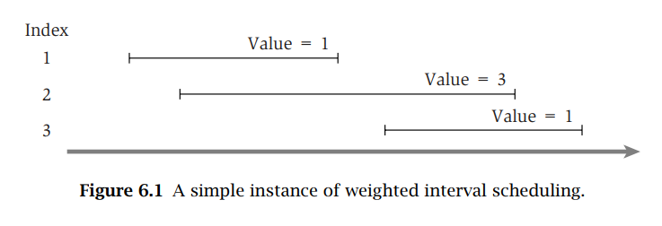

Slide 4
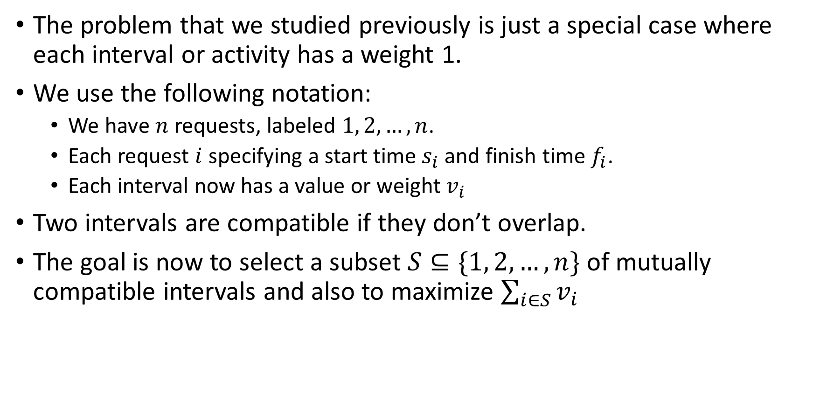
Designing a Recursive Algorithm
The problem that we studied previously is just a special case where each interval or activity has a weight 1.
We use the following notation:
We have $n$ requests, labeled $1, 2, …, n$.
Each request $i$ specifying a start time $s_{i}$ and finish time $f_{i}$.
Each interval now has a value or weight $v_{i}$
Two intervals are compatible if they don’t overlap.
The goal is now to select a subset $S⊆\{1, 2, …, n\}$ of mutually compatible intervals and also to maximize $\sum_{i∈S}{v_{i}}$

Slide 5
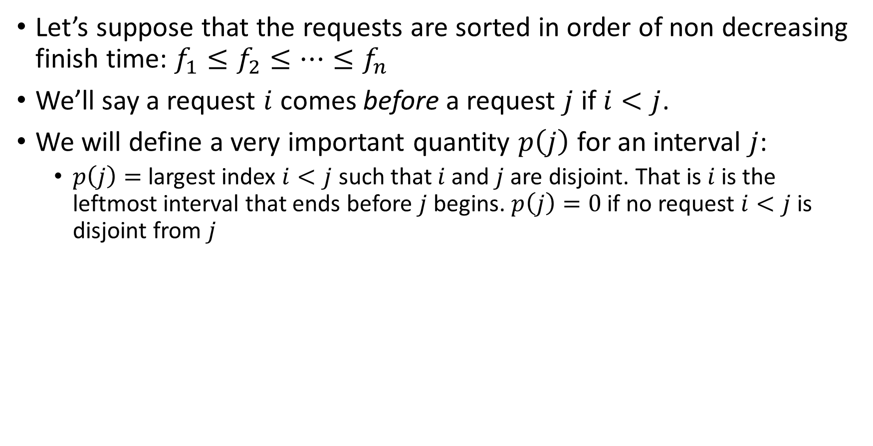
Designing a Recursive Algorithm (contd.)
Let’s suppose that the requests are sorted in order of non decreasing finish time: $f_{1}≤f_{2}≤…≤f_{n}$
We’ll say a request $i$ comes before a request $j$ if $i<j$.
We will define a very important quantity $p\left(j\right)$ for an interval $j$:
$p\left(j\right)=$ largest index $i<j$ such that $i$ and $j$ are disjoint. That is $i$ is the leftmost interval that ends before $j$ begins. $p\left(j\right)=0$ if no request $i<j$ is disjoint from $j$

Slide 6
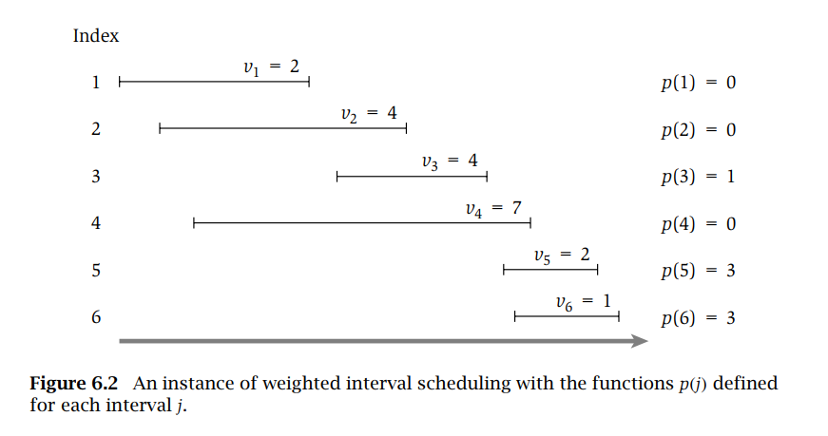

Slide 7

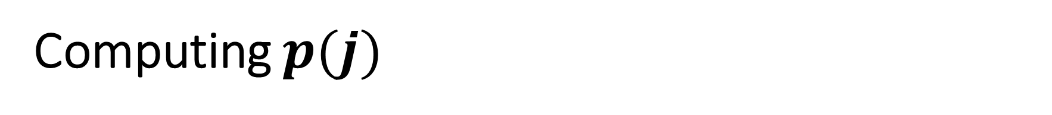
Computing $p(j)$
$p\left(j\right)=$ Compute($j$)
$l≔1, h≔j−1$
while $l≤h$ do
$m :=\left\lfloor (l+h)/2\right\rfloor$
if $f_{m}≤s_{j}$ then
if $f_{m+1}≤s_{j}$ then
$l :=m+1$
else
return $m$
end
else
$h :=m−1$
end
end
return $0$

Slide 8
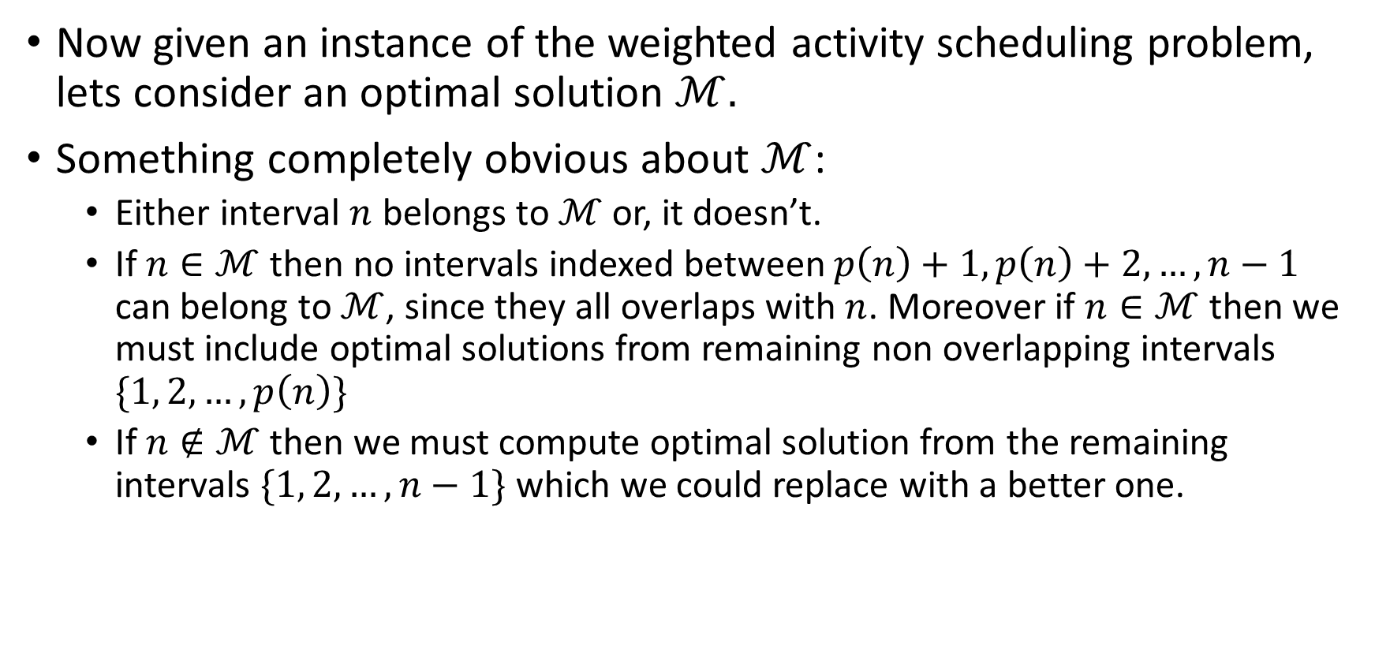
Designing a Recursive Algorithm (contd.)
Now given an instance of the weighted activity scheduling problem, lets consider an optimal solution $ℳ.$
Something completely obvious about $ℳ$:
Either interval $n$ belongs to $ℳ$ or, it doesn’t.
If $n∈ℳ$ then no intervals indexed between $p\left(n\right)+1, p\left(n\right)+2,…, n−1$ can belong to $ℳ$, since they all overlaps with $n$. Moreover if $n∈ℳ$ then we must include optimal solutions from remaining non overlapping intervals $\{1, 2, …, p\left(n\right)\}$
If $n∉ℳ$ then we must compute optimal solution from the remaining intervals $\{1, 2, …, n−1\}$ which we could replace with a better one.

Slide 9
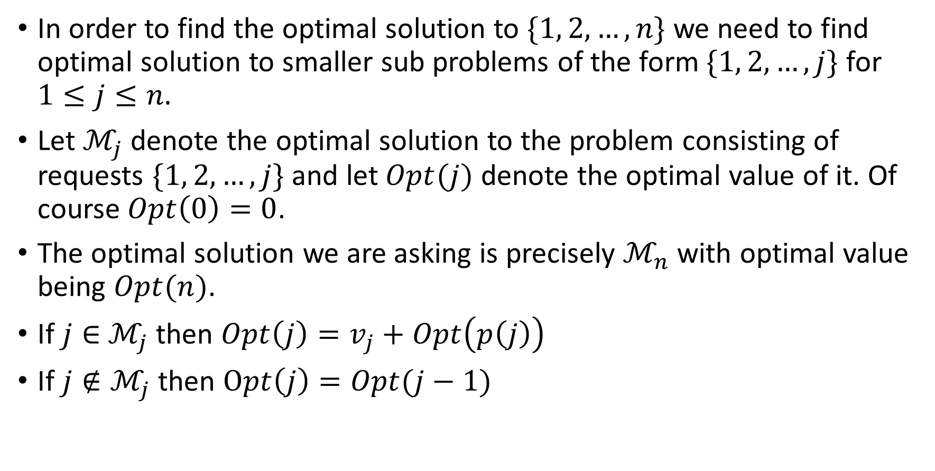
The Optimal Solution’s Computational Structure
In order to find the optimal solution to $\{1, 2, …, n\}$ we need to find optimal solution to smaller sub problems of the form $\{1, 2, …,j\}$ for $1≤j≤n.$
Let $ℳ_{j}$ denote the optimal solution to the problem consisting of requests $\{1, 2, …, j\}$ and let $Opt(j)$ denote the optimal value of it. Of course $Opt\left(0\right)=0$.
The optimal solution we are asking is precisely $ℳ_{n}$ with optimal value being $Opt(n)$.
If $j∈$ $ℳ_{j}$ then $Opt\left(j\right)=v_{j}+Opt\left(p\left(j\right)\right)$
If $j∉ℳ_{j}$ then $Opt\left(j\right)=Opt(j−1)$

Slide 10
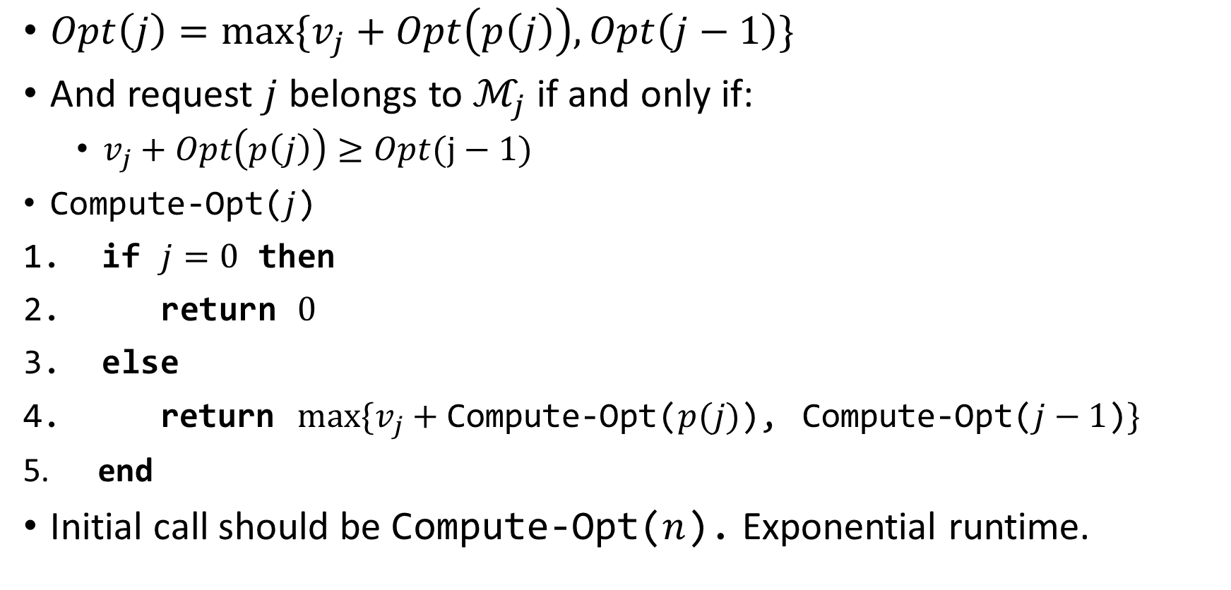
Our Recurrence Relation
$Opt\left(j\right)=max⁡\{v_{j}+Opt\left(p\left(j\right)\right), Opt\left(j−1\right)\}$
And request $j$ belongs to $ℳ_{j}$ if and only if:
$v_{j}+Opt\left(p\left(j\right)\right)≥Opt(j−1)$
Compute-Opt($j$)
if $j=0$ then
return $0$
else
return $max⁡\{v_{j}+$ Compute-Opt($p(j)$), Compute-Opt($j−1$)$\}$
end
Initial call should be Compute-Opt($n$). Exponential runtime.

Slide 11
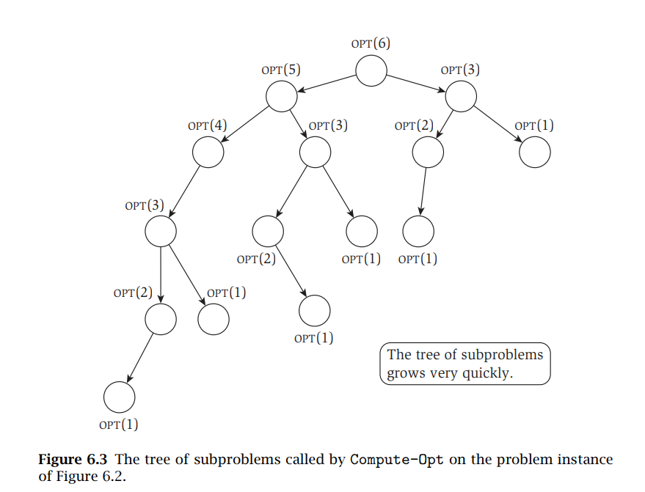

Slide 12
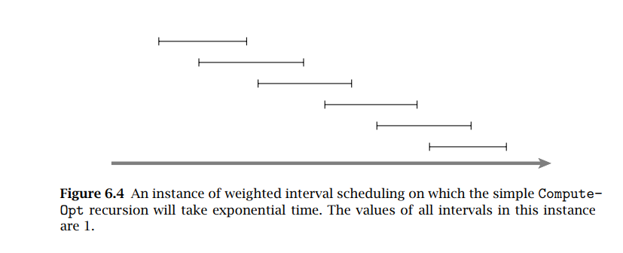

Why Naïve Recursive Algorithm is Bad (a worst extreme case)
To take a more extreme example, on a nicely layered instance like the one bellow, where $p\left(j\right)=j−2$ for each $j = 2, 3, 4, . . . , n$, we see that Compute-Opt($j$) generates separate recursive calls on problems of sizes $j−1$ and $j−2$. In other words, the total number of calls made to Compute-Opt on this instance will grow like the Fibonacci numbers, which increase exponentially.

Slide 13
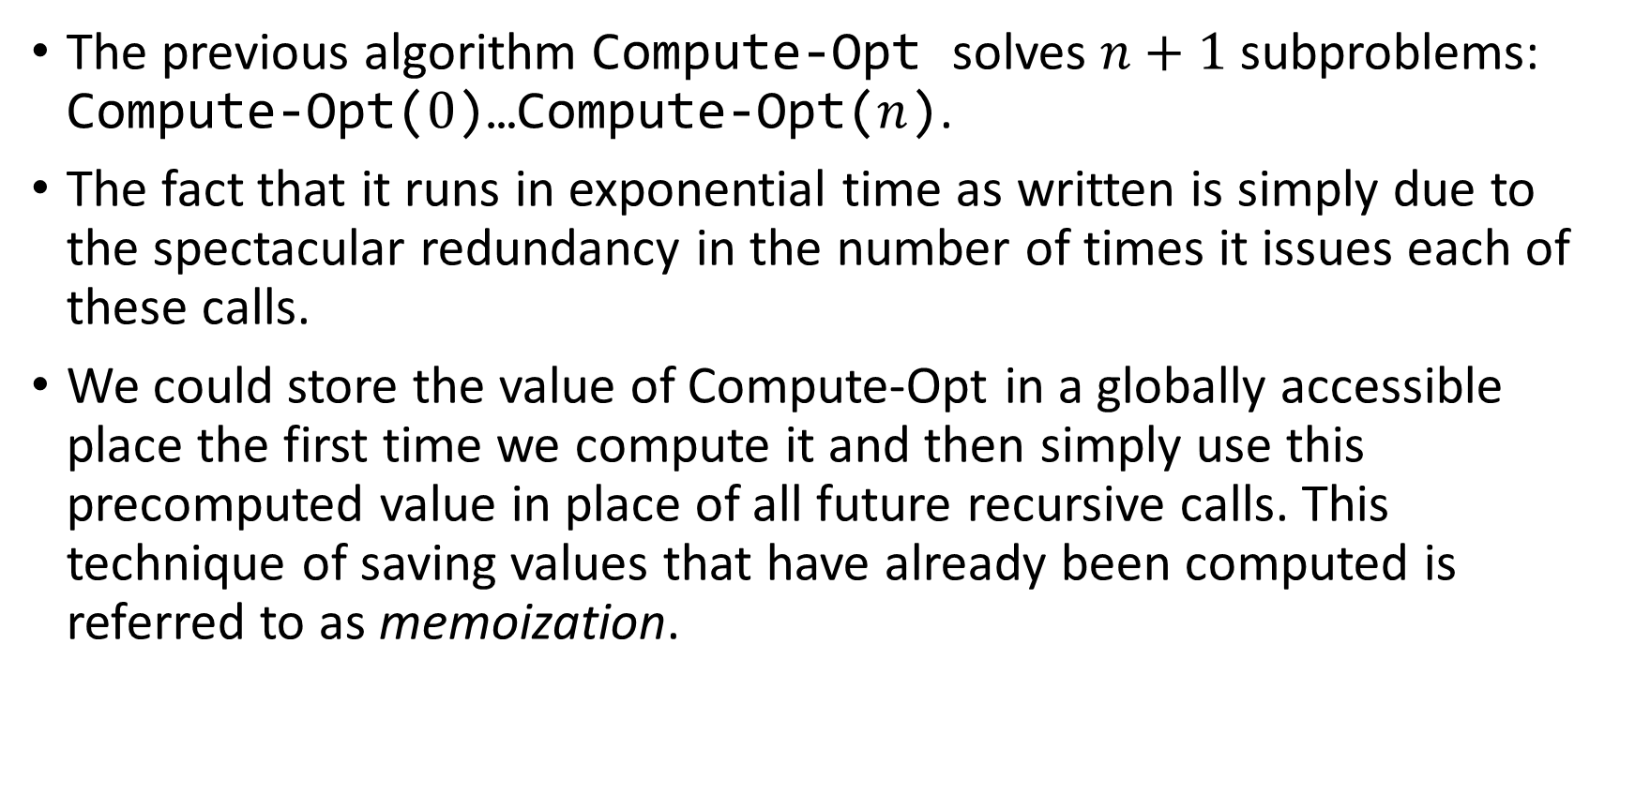
Memoizing The Recursions
The previous algorithm Compute-Opt solves $n+1$ subproblems: Compute-Opt($0$)…Compute-Opt($n$).
The fact that it runs in exponential time as written is simply due to the spectacular redundancy in the number of times it issues each of these calls.
We could store the value of Compute-Opt in a globally accessible place the first time we compute it and then simply use this precomputed value in place of all future recursive calls. This technique of saving values that have already been computed is referred to as memoization.

Slide 14
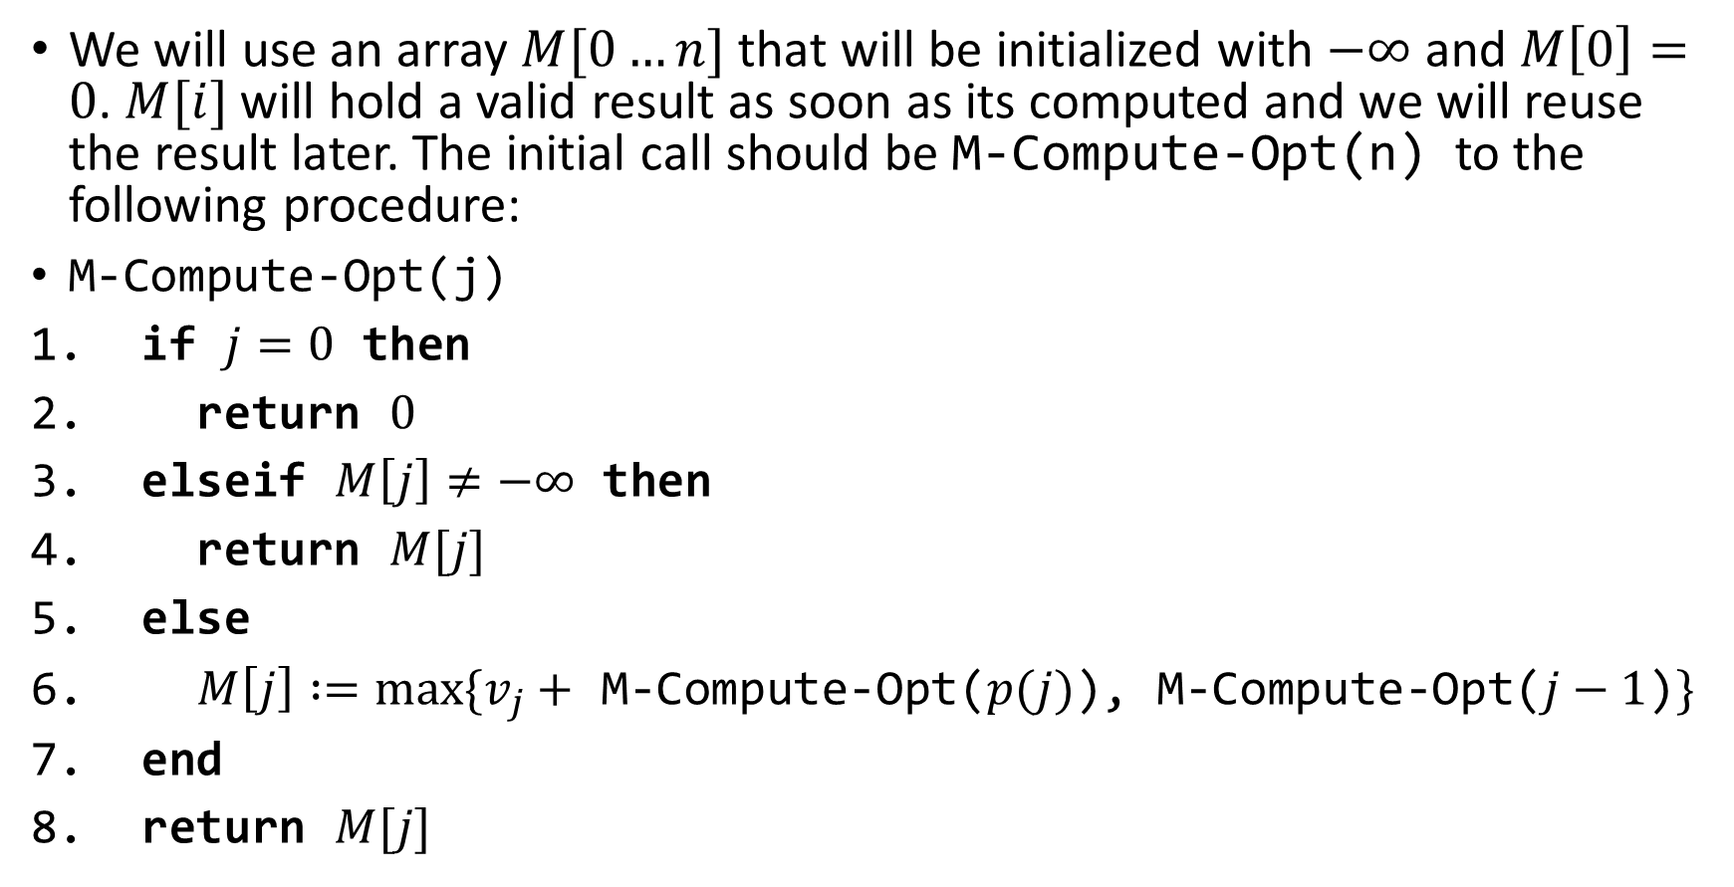
Memoizing The Recursions(contd.)
We will use an array $M[0…n]$ that will be initialized with $−∞$ and $M\left[0\right]=0$. $M[i]$ will hold a valid result as soon as its computed and we will reuse the result later. The initial call should be M-Compute-Opt(n) to the following procedure:
M-Compute-Opt(j)
if $j=0$ then
return $0$
elseif $M\left[j\right]≠−∞$ then
return $M[j]$
else
$M\left[j\right] :=max⁡\{v_{j}+$ M-Compute-Opt($p(j)$), M-Compute-Opt($j−1$)$\}$
end
return $M[j]$

Slide 15
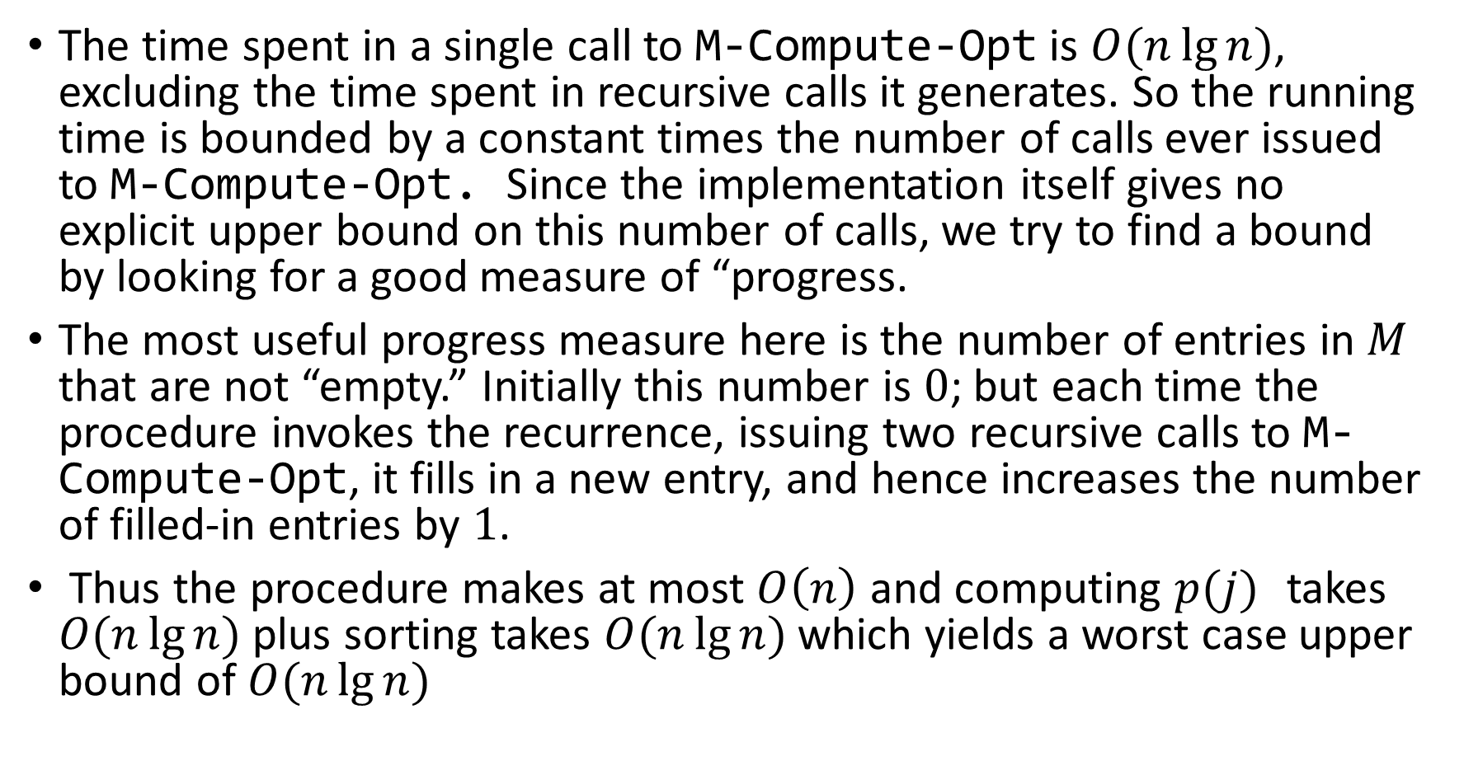
Analyzing the Memoized Version
The time spent in a single call to M-Compute-Opt is $O(n\lg{n})$, excluding the time spent in recursive calls it generates. So the running time is bounded by a constant times the number of calls ever issued to M-Compute-Opt. Since the implementation itself gives no explicit upper bound on this number of calls, we try to find a bound by looking for a good measure of “progress.
The most useful progress measure here is the number of entries in $M$ that are not “empty.” Initially this number is $0$; but each time the procedure invokes the recurrence, issuing two recursive calls to M-Compute-Opt, it fills in a new entry, and hence increases the number of filled-in entries by $1$.
Thus the procedure makes at most $O\left(n\right)$ and computing $p(j)$ takes $O(n\lg{n)}$plus sorting takes $O(n\lg{n)}$which yields a worst case upper bound of $O(n\lg{n)}$

Slide 16
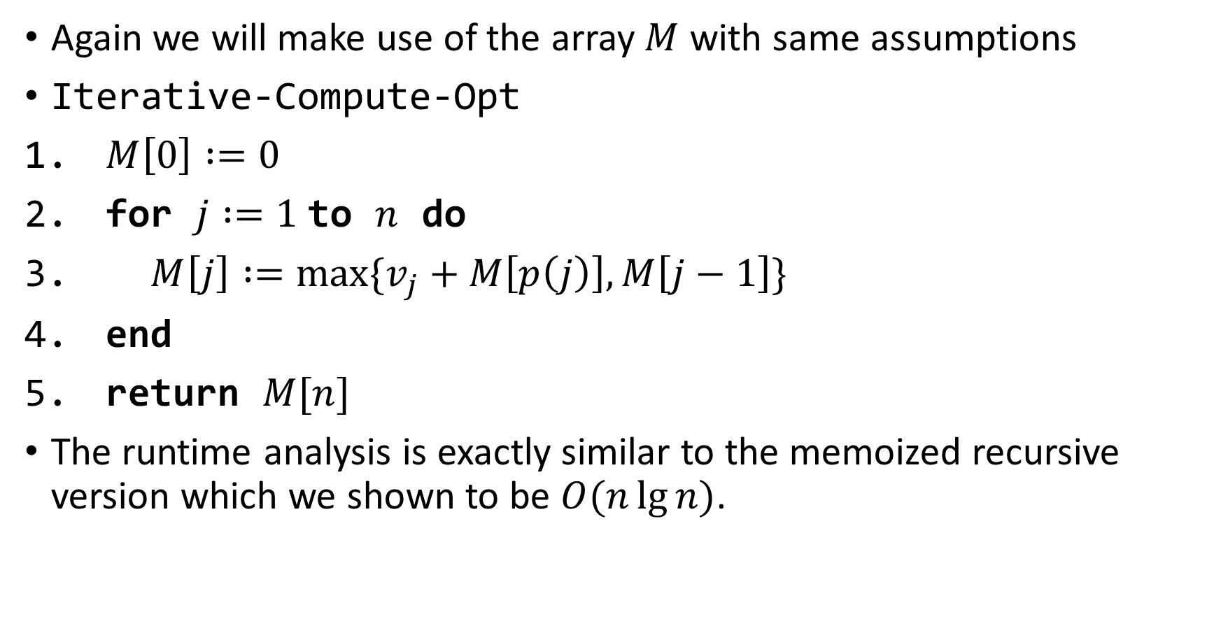
Computing the Optimal Solution Iteratively(bottom up DP)
Again we will make use of the array $M$ with same assumptions
Iterative-Compute-Opt
$M\left[0\right] :=0$
for $j :=1$to $n$ do
$M\left[j\right] :=max⁡\{v_{j}+M\left[p\left(j\right)\right], M\left[j−1\right]\}$
end
return $M[n]$
The runtime analysis is exactly similar to the memoized recursive version which we shown to be $O(n\lg{n)}$.

Slide 17
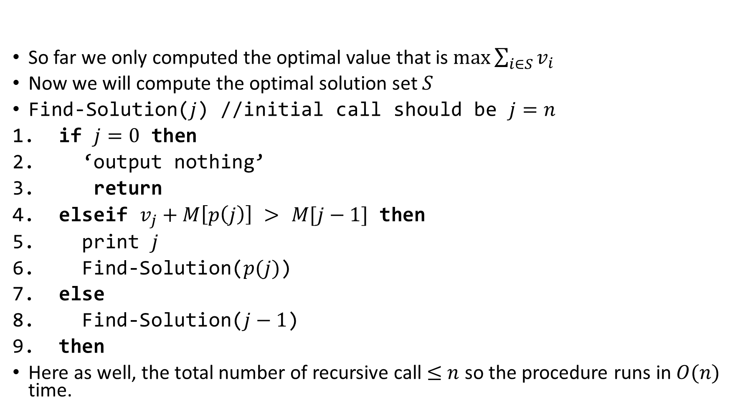
Computing Optimal Solution
So far we only computed the optimal value that is $\max{\sum_{i∈S}{v_{i}}}$
Now we will compute the optimal solution set $S$
Find-Solution($j$) //initial call should be $j=n$
if $j=0$ then
‘output nothing’
return
elseif $v_{j}+M\left[p\left(j\right)\right]$ $>$ $M[j−1]$ then
print $j$
Find-Solution($p(j)$)
else
Find-Solution($j−1$)
then
Here as well, the total number of recursive call $≤$ $n$ so the procedure runs in $O(n)$ time.

Slide 18
